Slide 1
Computer Organization & Assembly Language
Array Addressing

Slide 2
One Dimensional Array
An ordered list of elements
Examples:
MSG DB ‘abcde’
W DW 10, 20, 30, 40, 50, 60
Base Address of an array or offset address assigned to an array
Offset Address | Symbolic Address | Decimal Content
0200h | W | 10
0202h | W + 2h | 20
0204h | W + 4h | 30
0206h | W + 6h | 40
0208h | W + 8h | 50
020Ah | W + Ah | 60

Slide 3
The DUP Operator
Used to define an array if initial value of elements are same.
Examples:
GAMMA DW 100 DUP (0) ;sets an array of 100 elements initialized to 0
DELTA DB 20 DUP (?) ; creates an array with 20 uninitialized bytes
Nested DUP:
LINE DB 5, 4, 3 DUP (2, 3 DUP (0), 1)
Which is equivalent to:
LINE DB 5, 4, 2, 0, 0, 0, 1 , 2, 0, 0, 0, 1 , 2, 0, 0, 0, 1

Slide 4
Location of Array Elements
Address of an array element = base address + constant
Suppose A is an array, S denotes no. of bytes in each element (S = 1 for a byte array, S = 2 for a word array).
Position of elements in array A:
Position | Location
1 | A
2 | A = 1 * S
. | .
. | .
N | A = (N-1) * S

Slide 5
Example 10.1
Exchange the 10th and 25th elements in a word array W
Solution:
MOV AX, W + 18 ; 10th element = 9 * 2
XCHG W + 48, AX ; 25th element = 24 * 2
MOV W + 18, AX

Slide 6
Addressing Modes

Slide 7
Default Segment and Offset Registers
CS: IP
SS: SP or BP
DS: BX, DI, SI

Slide 8
Addressing Mode
The way an operand is specified is known as its addressing mode.
Modes
  Register Mode (Operand is register)
  Immediate (Operand is constant)
  Direct (Operand is variable)
  Indirect
    Register Indirect
    Based
    Indexed
    Based Indexed (used with 2D array)

Slide 9
Register Mode
Operand = Register
Can be 8 or 16 bit register
Efficient as no memory access required.
Example
mov ax, bx
mov cl, al
mov si, ax

Slide 10
Immediate Mode
Operand = Constant Expression
Constant Expression can be a number, a character, or string.
Example
mov ax, 5
mov dl,’a’
Important: Destination operand cannot be in immediate mode.

Slide 11
Direct Mode
Direct operand refers to the contents of memory at a location identified by the label in the data segment.
Example
    .data
    count db 20
    wordList dw 1000h,2000h
    .code
    mov al, count
    mov bx, wordList

Slide 12
Contd..
    .data
    array db 10,20,30,40
    .code
    mov al, array
    mov bl, array+1
    mov cl, array+2
    mov dl, array+3

Slide 13
Offset Operator
Used to move the offset of a label into a register or variable.
Example
  Assume offset of aWord is 0200H
    .data
    aWord dw 1234
    .code
    mov bx, offset aWord

Slide 14
Register Indirect Mode
Register contains the offset of data in memory.
So, the register becomes a pointer to the memory location.
Syntax:
[register]
BX, SI, DI with default segment DS
BP with default segment SS
Remember the difference:
MOV AX, SI
MOV AX, [SI]

Slide 15
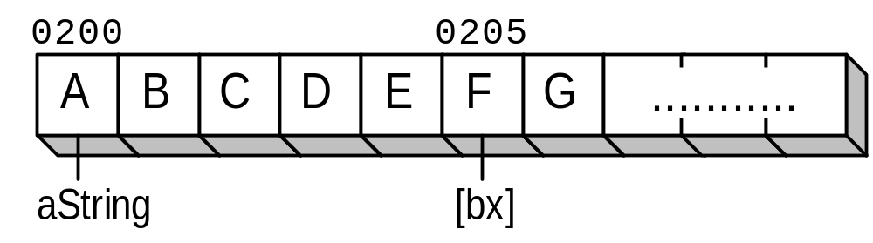
Example
.data
aString db "ABCDEFG“
.code
mov bx,offset aString
add bx,5
mov dl,[bx]
Also solve Example 10.2, 10.3 and 10. 4 from textbook

Slide 16
Based and Indexed Modes
A register is added to a displacement to generate an effective address.
Register may be: SI, DI, BX, or BP.
Displacement can be a number or a label
Based: If BX pr BP used
Indexed: IF SI or DI used
Can be written as:
displacement [register]
displacement + [register]
[register] + displacement
[displacement + register]
[register + displacement ]

Slide 17

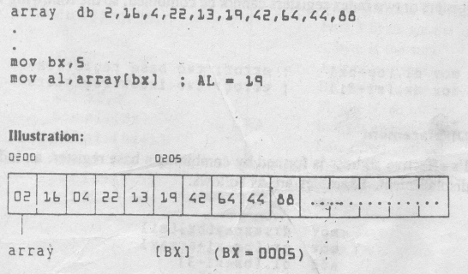
Example

Slide 18
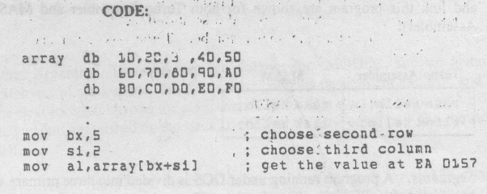
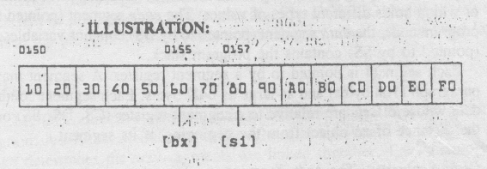
Example

Slide 19
Indirect Addressing – Summary
Indirect Operands
  [si]. [di], [bx], [bp]
Based and Indexed Operands
    array[si], array[di], array[bx]
Base-Index Operands
    [bx+si], [bx+di]
Base-Index with Displacement
    array[bx+si], array[bx+di]

Slide 20
Adding 8-bit Integers
.data
aList db 10h,20h,30h
sum db 0
.code
mov bx,offset aList
mov al,[bx] ; AL = 10h
inc bx
add al,[bx] ; AL = 30h
inc bx
add al,[bx] ; AL = 60h
mov si,offset sum ; get offset of sum
mov [si],al ; store the sum
If you want to paste a code example such as this into a program, remember that the code segment must always begin with the following statements:
mov ax,@data
mov ds,ax

Slide 21
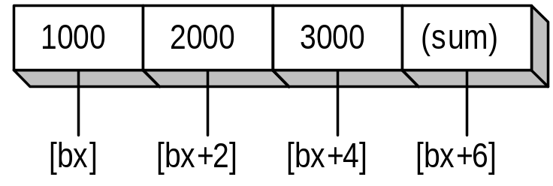
Adding 16-bit Integers
.data
wordList dw 1000h,2000h,3000h, 0
.code
mov bx,offset wordList
mov ax,[bx] ; first number
add ax,[bx+2] ; second number
add ax,[bx+4] ; third number
mov [bx+6],ax ; store the sum

Slide 22
Displaying a String
.data
string db "This is a string."
COUNT = ($–string) ; calculate string length
.code
mov cx,COUNT ; loop counter
mov si,offset string
L1:
mov ah,2 ; DOS function: display char
mov dl,[si] ; get character from array
int 21h ; display it now
inc si ; point to next character
Loop L1 ; decrement CX, repeat until 0

Slide 23
Summing an Integer Array
.data
intarray dw 0100h,0200h,0300h,0400h
COUNT = ($ – intarray) / (TYPE intarray)
.code
mov ax,0 ; zero accumulator
mov di,offset intarray ; address of array
mov cx,COUNT ; loop counter
L1:
add ax,[di] ; add an integer
add di,TYPE intarray ; point to next integer
Loop L1 ; repeat until CX = 0

Slide 24
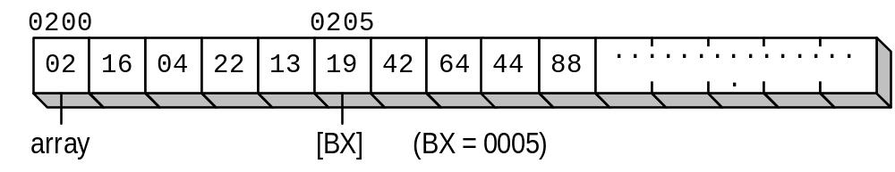
Two-Dimensional Array Example
Each row of this table contains five bytes. BX points to the beginning of the second row:
.data
ROWSIZE = 5
array db 2h, 16h, 4h, 22h, 13h
db 19h, 42h, 64h, 44h, 88h
.code
mov bx,ROWSIZE
mov al,array[bx] ; AL = 19h

Slide 25
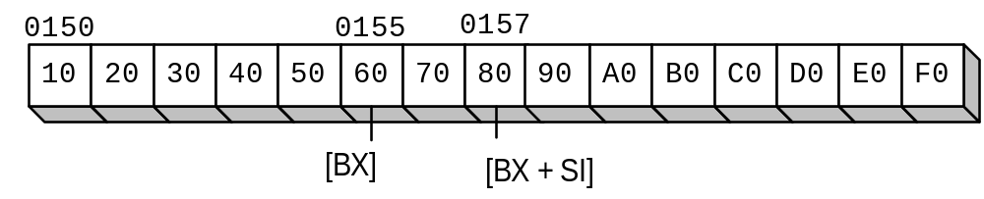
Based-Index Operands
Add the value of a base register to an index register, producing an effective address of 0157:
BX = 0155, SI = 0002
Example...

Slide 26
Base-Index Example
.data
ROWSIZE = 5
array db 10h, 20h, 30h, 40h, 50h
db 60h, 70h, 80h, 90h,0A0h
db 0B0h,0C0h,0D0h,0E0h,0F0h
.code
mov bx,offset array ; point to the array at 0150
add bx,ROWSIZE ; choose second row
mov si,2 ; choose third column
mov al,[bx + si] ; get the value at 0157

Slide 27
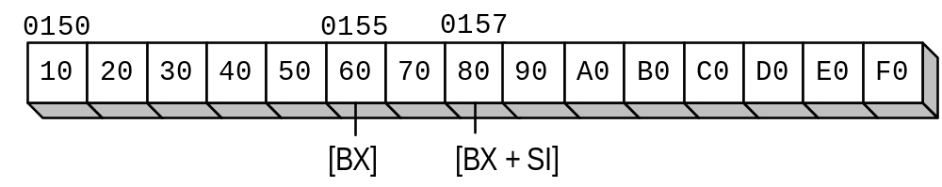
Base-Index with Displacement
.data
ROWSIZE = 5
array db 10h, 20h, 30h, 40h, 50h
db 60h, 70h, 80h, 90h,0A0h
db 0B0h,0C0h,0D0h,0E0h,0F0h
.code
mov bx,ROWSIZE ; row 1
mov si,2 ; column 2
mov dl,array[bx + si] ; DL = 80h

